Slide 1
STOCK MANAGEMENT SYSTEM
An interface between the customer and the salesman.
18WH1A1216 - Pravallika N
18WH1A1218 - Harshitha K
18WH1A1209 - Tanmayee B
18WH1A1252 - Amrutha Ch
18WH1A1235 - Ambica V
18WH1A1226 - Himabindu B
18WH1A1232 - Fareesa
19WH5A1201 - Harika D

Slide 2
TOC
Overview
Understanding the scope & design
Project objective
Additional Features
Target audience
Cycle diagram

Slide 3
Overview
The stock maintenance system must take care of sales information of the company and must analyze the potential of the trade. It maintains the number of items that are added or removed. The salesperson is allowed to update information and view the database.The purpose of this presentation is to define the requirements of designing a stock maintenance system

Slide 4
Understanding the problem statement.
01
Stock management applies to every item a business uses to produce its products or services – from raw materials to finished goods. In other words, stock management covers every aspect of a business’s inventory.
02
Choosing the Categories.
03
Modeling our software based on the interfaces required.

Slide 5
Project objective
Nearly 81% of consumers experienced an “out-of-stock” situation in the past 12 months, resulting in lost sales for retailers and lots of disappointment for in-store shoppers.
So a well-designed ‘Inventory management system’ is necessary for any business.

Slide 6
Additional Features

Slide 7
FEATURE 1
Analytics and visibility
Cloud-based stock management software gives businesses the ability to track stock in real time, generate reports for improved insights and collaboration, and access the data anytime, anywhere using mobile devices.

Slide 8
FEATURE 2
AI
Built-in artificial intelligence capabilities provide data-based recommendations for stock levels, predict trends to help you stay ahead of the curve, and help you address emerging issues before they become larger problems.

Slide 9
Target audience
Company/ Market Data Provider.
Customers
Sales persons

Slide 10
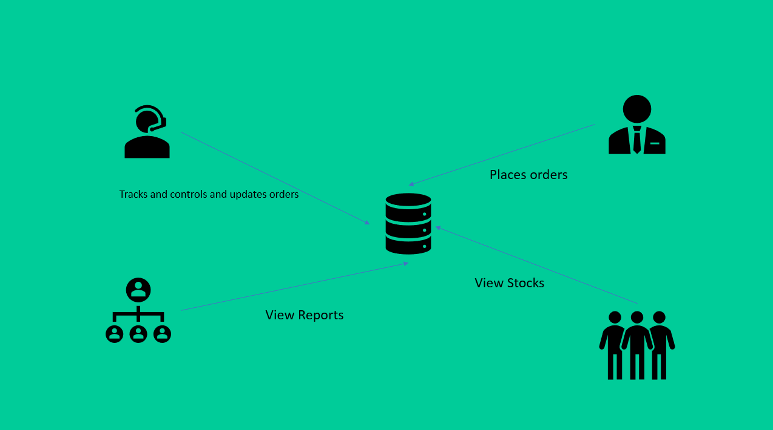
Cycle diagram

Slide 11
